Slide 1
Presentation.
Created by
ASHWINI G
2ND SEM MCA
ROLL NO :-23MCA004
COMPUTER NETWORKS

Slide 2
Contents:
Bus Topology
Ring Topology

Slide 3
Bus Topology
Bus topology, alternatively known as line topology, is a type of network topology where all devices on a network are connected to a single cable, called a bus or backbone. This cable serves as a shared communication line, allowing all devices (computers, printers, etc.) to receive the same signal simultaneously.

Slide 4
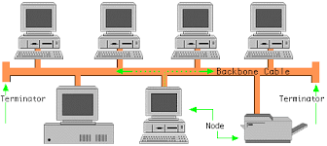
How Bus Topology Works
Data is sent in both directions along with bus
The bus has terminators at both ends to prevent signal reflection
Devices listen to the data on the bus and check if the data is intended for them

Slide 5
Advantages of Bus Topology
Easy to install: This topology is easy to install and requires minimal configuration.
Scalable: It can be easily scaled up by adding repeaters or hubs to extend the network's range.
Efficient: Bus topology is an efficient way of transmitting data, allowing multiple nodes to transmit data simultaneously.
Reliable: Since all the nodes are connected to a single wire, it provides redundancy and ensures that the network remains operational even if one node fails.

Slide 6
Disadvantages of Bus Topology
Core failure: The entire network will fail if the central cable (bus or backbone) gets damaged or faulty.
Low security: This is a notable security issue. All nodes in the network can hear what data is transmitted to other nodes in the network.
Limited speed: The network's performance decreases as the number of devices connected increases, as all devices share the same bandwidth.
Not suitable for large networks: Due to cable length limitations, bus topology is unsuitable for large networks.

Slide 7
Ring Topology
The ring topology is a network topology in which devices in a network are connected to each other in a closed ring arrangement.
Each device is therefore directly connected to exactly two other devices, creating a closed communication ring. In this topology, data packets are forwarded from one device to the next until the destination is reached.

Slide 8
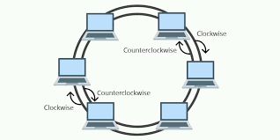
How Ring Topology Works
A token circulates around the ring, allowing only the device with the token to send data.
Data is sent from one device to the next until it reaches the destination.
Each device checks if the data is meant for it, if not it passes the data to the next device .

Slide 9
Advantages of Ring Topology
In this data flows in one direction which reduces the chance of packet collisions.
In this topology additional workstations can be added after without impacting performance of the network.
There is no need of server to control the connectivity among the nodes in the topology.
Speed to transfer the data is very high in this type of topology.
Due to the presence of token passing the performance of ring topology becomes better than bus topology under heavy traffic.

Slide 10
Disadvantages of Ring Topology
Due to the Uni-directional Ring, a data packet (token) must have to pass through all the nodes.
Addition and removal of any node during a network is difficult and may cause issue in network activity.
Total dependence in on one cable.
Difficult to troubleshoot the ring.
In order for all the computer to communicate with each other, all computer must be turned on.
Total dependence in on one cable.

Slide 11


Thank you

